Slide 1
ONLINE VOTING SYSTEM
TS- WEB/CC/AI TRACK CAPSTONE PROJECT
Presented By:
1. Miss Adepu Anusha – ASRA Hyderabad (Btech ECE)
2. Miss Allu Geethanjali – ASRA Hyderabad (Btech ECE)
Guided By: Umamaheshwari

Slide 2
OUTLINE
Abstract
Problem Statement (Should not include solution)
Aims , Objective & Proposed System/Solution
System Design
System Development Approach(Technology Used)
Algorithm & Deployment
Conclusion
References
Future Scope

Slide 3

ABSTRACT
Our project deals with Digital voting system that facilitates user(voter), candidate and administrator (who will be in charge and will verify all the user and information) to participate in Digital voting.
our Digital voting system is highly secured, and it has a simple and interactive user interface.
The proposed Digital portal is secured and have unique security feature such as unique id generation that adds another layer of security (except login id and password) and gives admin the ability to verify the user information and to decide whether he is eligible to vote or not.
It also creates and manages voting and an election detail as all the users must login by user name and password and click on candidates to register vote.

Slide 4
PROBLEM STATEMENT
Many people are facing problems during voting manually:
➔ Much time is required
➔ As it has been observed that in some places booth capturing has been reported.

Slide 5

PROPOSED SOLUTION
To solve the problem, we proposed a better solution which is a Digital voting.
➔The main thing that we need to do is deliver information about elections.
➔And also deliver information about different political parties and their leaders.

Slide 6
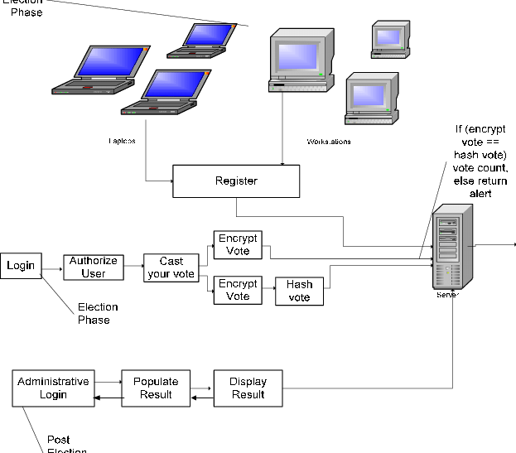
SYSTEM ARCHITECTURE
System architecture

Slide 7
SYSTEM DEPLOYMENT APPROACH
Software Requirements :
MySQL
JAVA
Testing(XAMPP SERVER)
Web-browsers : Chrome
Hardware Requirements :
Processor:800 MHz Intel Pentium or equivalent
Memory:512
Disk space:750 of free space

Slide 8
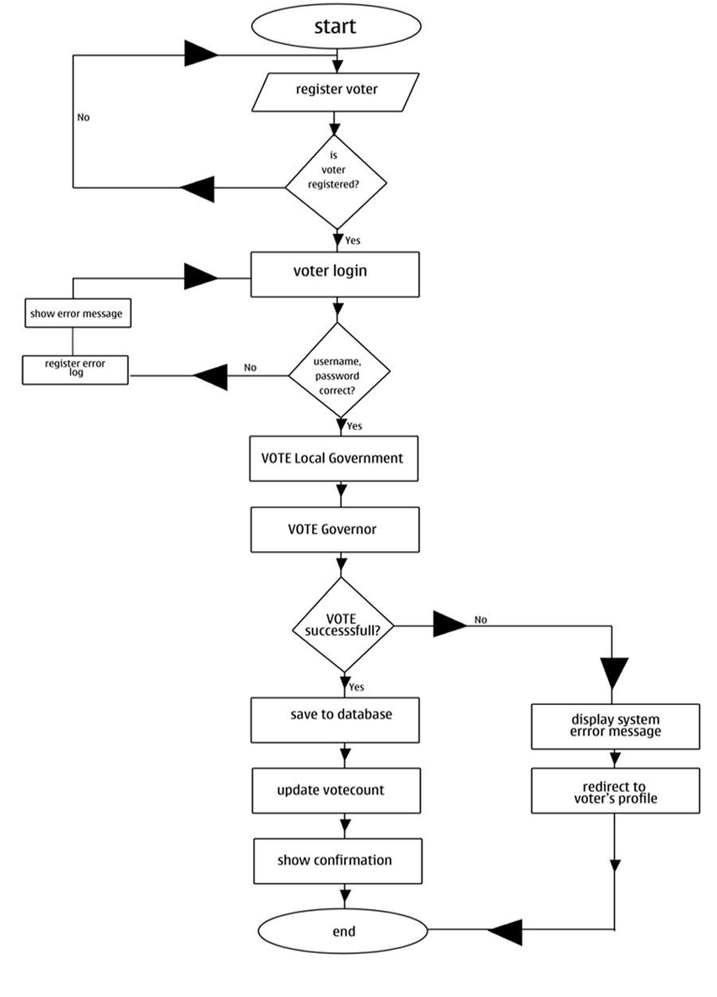
Algorithm & Deployment
Flow chart for the design of the voting system. Once a user goes to the website as a voter there are two operations that can be done by the user; Voting or Viewing the voting exercise.
Every user (valid or invalid) voter can view voting process at real-time.

Slide 9
THANK YOU

